Slide 1

WELCOME To Iron Book Store

Slide 2
What is the Content?
Description of the dataset
Bullet points
How the recommender works
Some examples of the Model ☺

Slide 3
Dataset
Total Records
52478
49927
Number of Authors
28227
Number of Books
81 Languages
41 Books from ‘The New York Times Fiction Best Sellers of 2021’
10614 Books received awards
20 Genres
‘Goodreads Best Books Ever’ dataset

Slide 4
Most Rated Authors

Slide 5
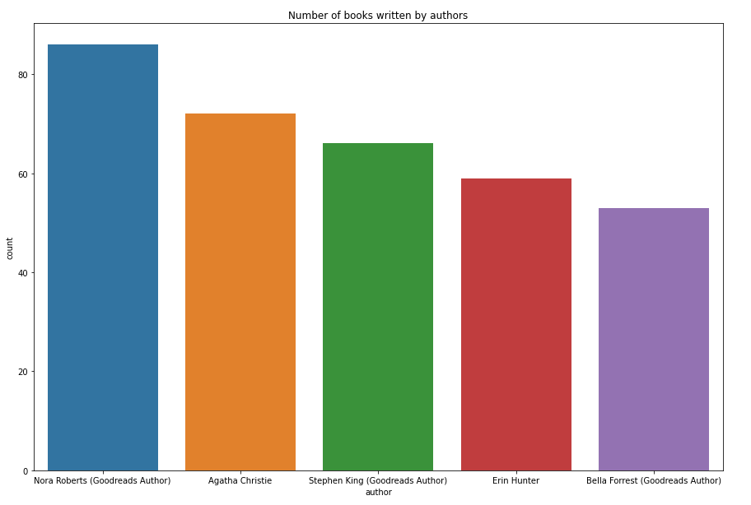

Slide 6
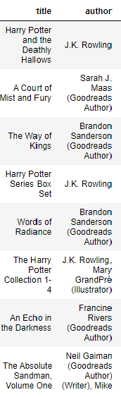
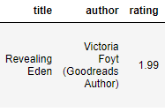
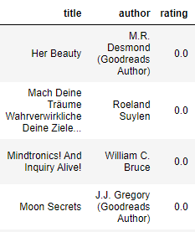
Underrated
Most Rated Books
Not popular at all

Slide 7
Recommender System

Slide 8
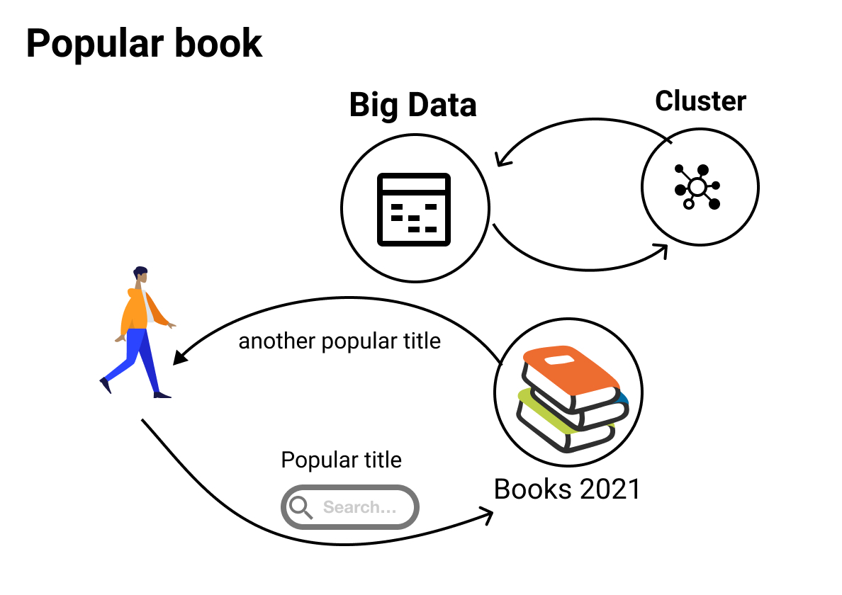

Slide 9
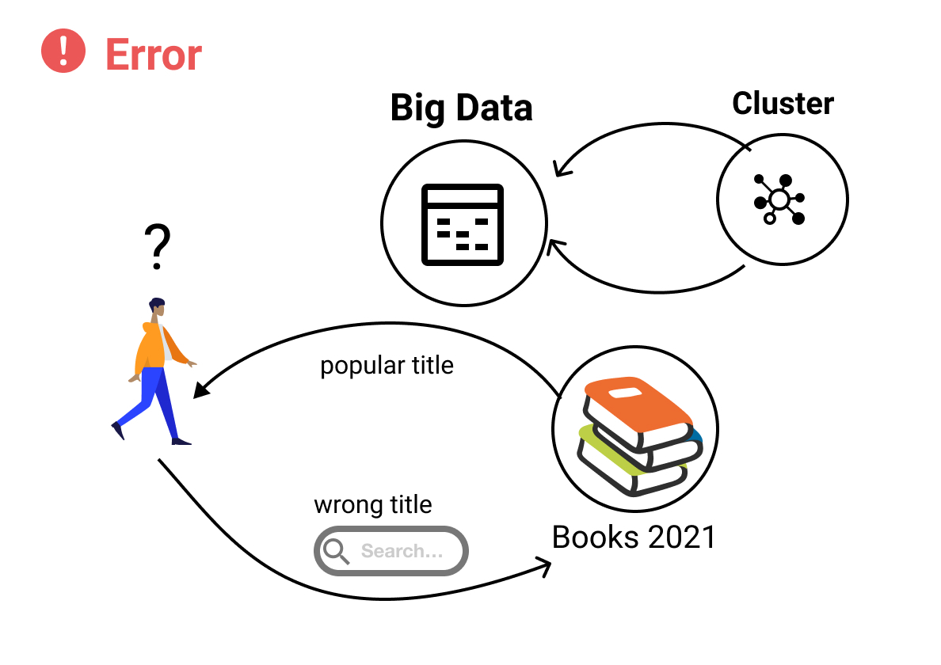
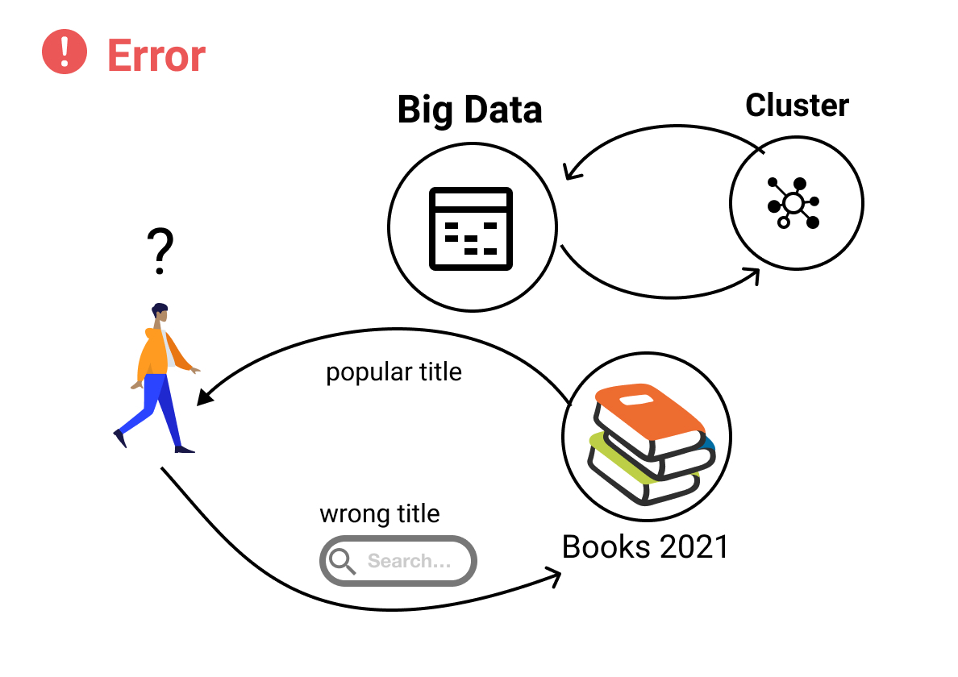

Slide 10
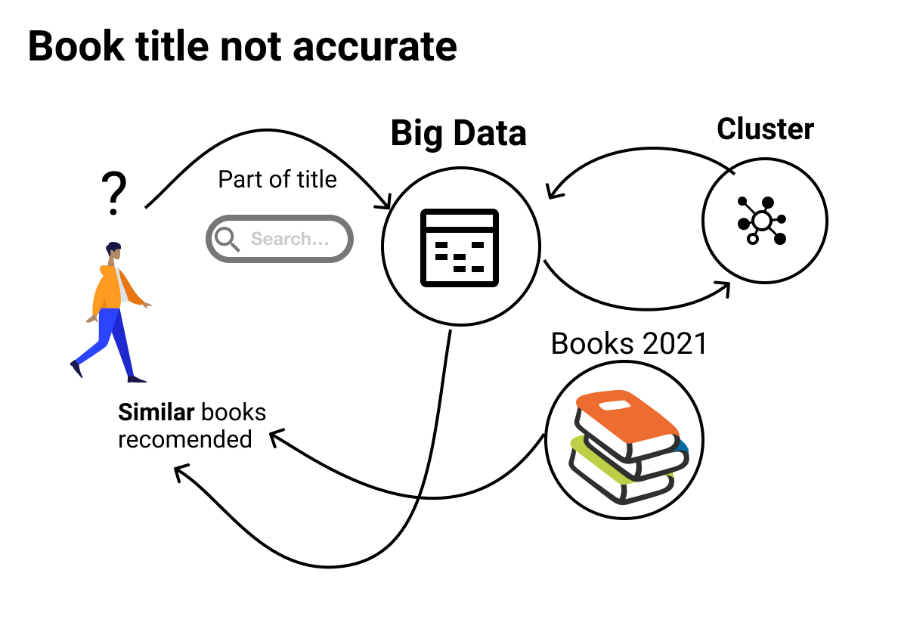

Slide 11
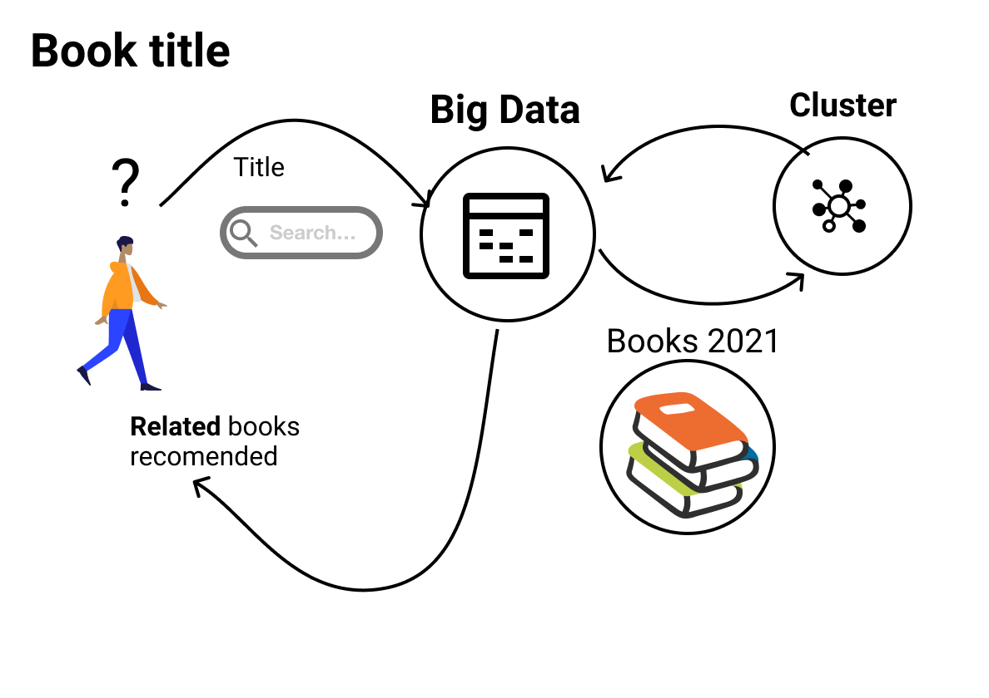

Slide 12
Let’s have some examples

Slide 13
Thank You for Choosing Iron Book Store
THE END

